Slide 1

Flight Price Prediction
Chethan B. K.

Slide 2
Table of Contents
Introduction
Analytical Problem Framing
Data Analysis
Assumptions
Machine Learning Models
Results and Conclusion
Limitations and Scope for Future Work

Slide 3
Introduction
Airline companies use complex algorithms to calculate flight prices given various conditions present at that particular time. These methods take financial, marketing, and various social factors into account to predict flight prices.
Nowadays, the number of people using flights has increased significantly. It is difficult for airlines to maintain prices since prices change dynamically due to different conditions. That’s why we will try to use machine learning to solve this problem. This can help airlines by predicting what prices they can maintain. It can also help customers to predict future flight prices and plan their journey accordingly.
Data was collected from yatra.com for the period of two weeks for economy, premium and business classes.

Slide 4
Analytical Problem Framing
In this analysis, we will be predicting the flight price for various class in domestic flights
Using this as a base, I have collected the data from few websites. The data was collected the period of two weeks. I have included various features like flight class, duration, number of stops between destination and so on
Once the data is collected, we will extract features from it, the data will be cleaned and pre-processed with all the necessary tools and the same will be used to build machine learning models in order to predict the price of the same

Slide 5
Data Analysis
The dataset has 28830 rows and 10 columns. Using this dataset we will be training the Machine Learning models on 70% of the data and the models will be tested on 30% data.
There are no missing values in the dataset. However, we can expect outliers and un-realistic values for certain variables
I’m extracting features like day of week, sessions in a day (i.e., morning, afternoon, night and so on), month, day, departure hour, departure minute and total duration in minutes.

Slide 6
There are no null values in the dataset and there are some categorical data in the dataset. Below are the final features we gathered post feature extraction from the actual collected data
Price | Price of the flight
airlines | Company name of the flight
stops | Number of stops to reach a destination
from_city | City of departure
to_city | Destination city
fclass | Flight class(Economy, Premium and Business)
dep_hour | Departure time (hour)
dep_minute | Departue time (min)
day_of_week | Day of week
duration_in_min | Flight duration (calculated in minutes)
day | Departure date (day)
month | Departure date (month)
year | Departure date (year)
session | Flight Session in a Day (Ex. Morning, Evening and so on)

Slide 7
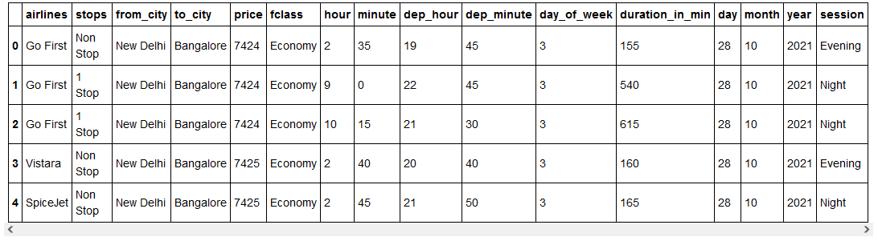
Looking at the glimpse of the dataset and proceeding with visualizing the relationship between the variables

Slide 8
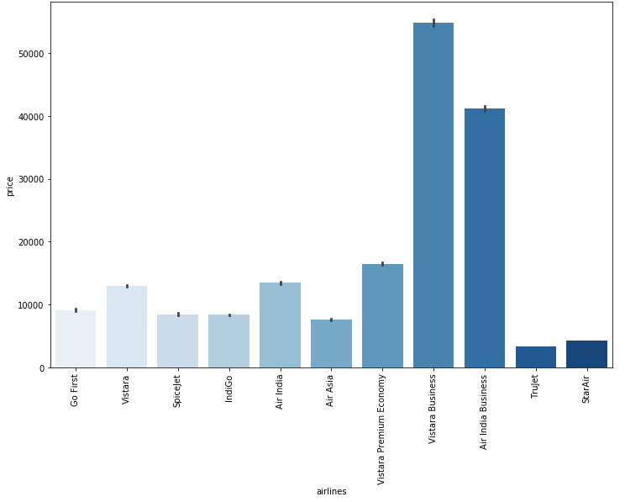
We can proceed with finding the correlation of the dependent variable with the independent variables. Let’s look at some of the highly correlated variables
Airlines v/s price
Vistara Business has the highest price and the lowest is Trujet (Economy)

Slide 9
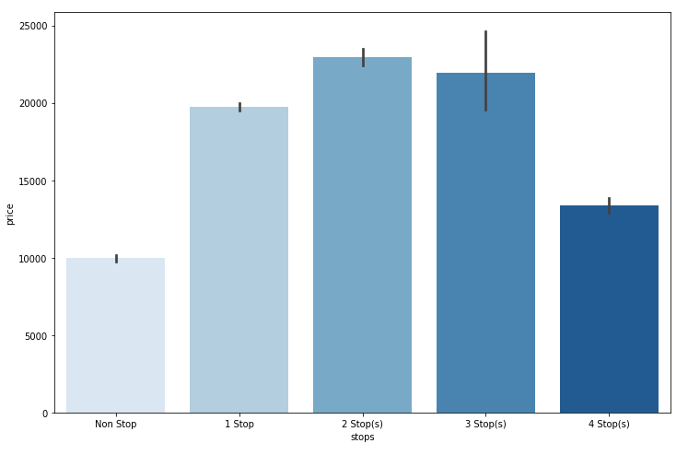
Stops v/s price
We can see that the nonstop flights and flights with 4 stops were cheaper when compared to flights with 1, 2 or 3 stops before reaching the destination

Slide 10
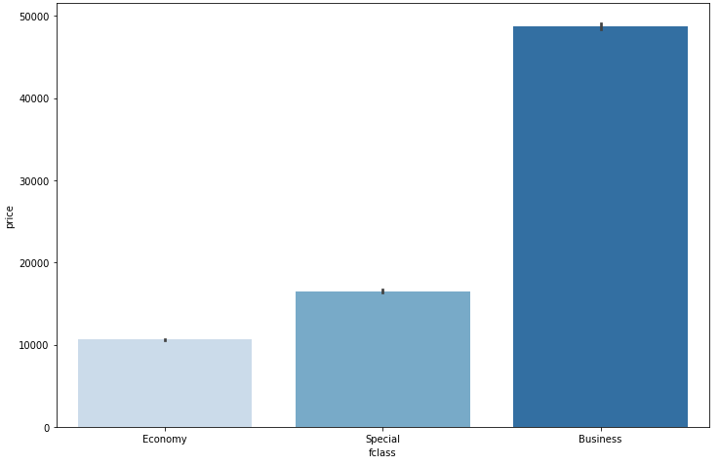
Class v/s price
Business class flights were costly when compared to other classes

Slide 11
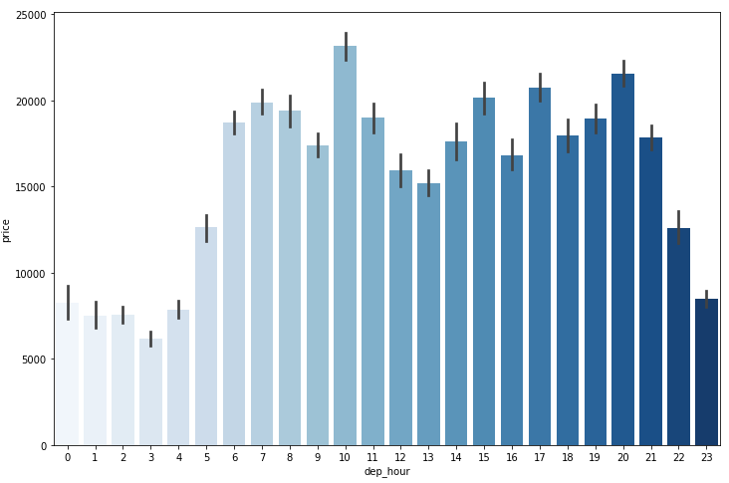
Departure hour v/s price
The flight price were cheaper between 11 PM to 4 AM and costlier during other time periods in a day

Slide 12
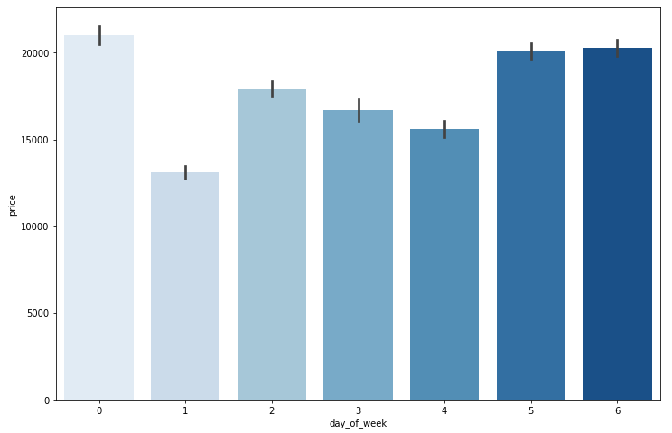
Day of week v/s price
The flight charges were costlier during weekends (Friday, Saturday and Sunday) and cheaper on Mondays

Slide 13
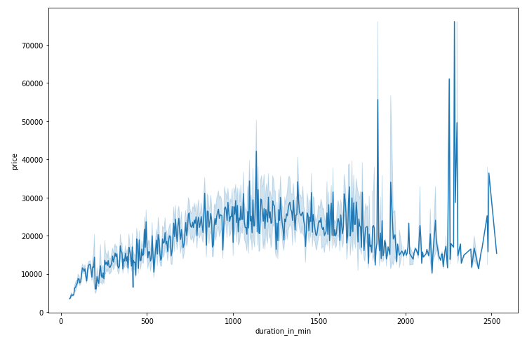
Duration in minutes v/s price
The duration of the flight is also related to the price, here when the flight duration increases, the price also increases

Slide 14
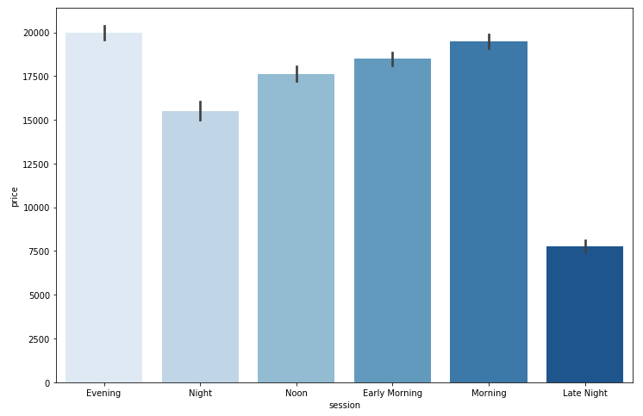
Session in a day v/s price
The evening flights were costlier and late night price were cheaper

Slide 15

Before proceeding with the further steps, I’m encoding the categorical variables so that I can find the correlation coefficients and identify the multicollinearity issue with the dataset.
In order to perform encoding, I’m using ordinal encoder to convert categorical variables into numeric variables.

Slide 16
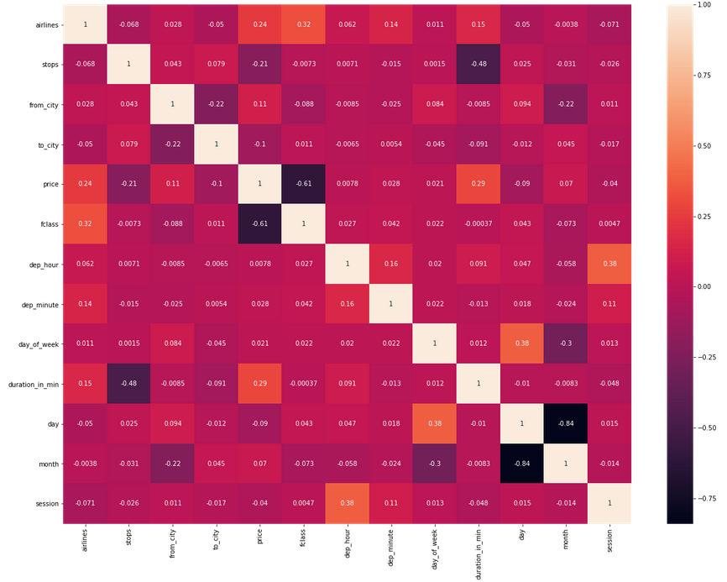
Now that we have analyzed the correlation between the dependent and independent variables, we can move forward in analyzing the multi-collinearity. From the heat-map I can see some of the independent variables are correlated and I can see multi-collinearity in the dataset.

Slide 17
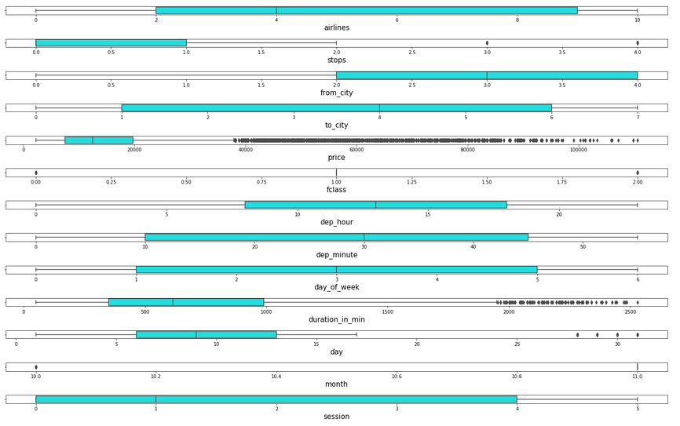
There is no multi-collinearlity issue with the dataset, Therefore I’m proceeding with further analysis and checking for outliers in the continuous data variables within the dataset using boxplot
I can see that there are lot of outliers in the dataset. Hence I’m proceeding with handling the outliers with the z-score method.

Slide 18
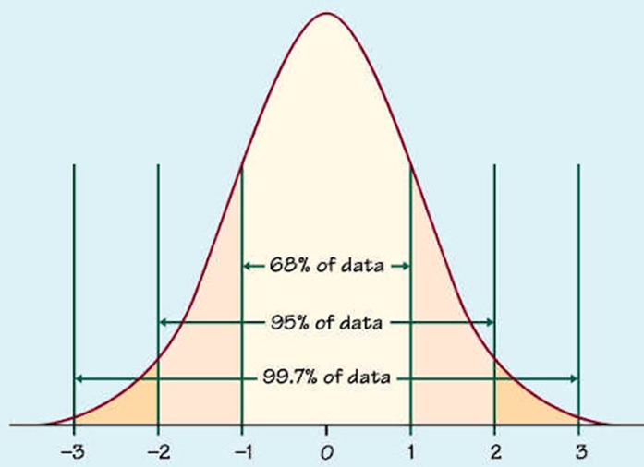
It is assumed that close to 99.7% data lies between -3 to +3 standard deviation. We can consider the remaining data (0.03) to be outlier.
Therefore using the z-score method, I’m taking the data within the range of -2.5 to +2.5 standard deviation to control the outlier.

Slide 19
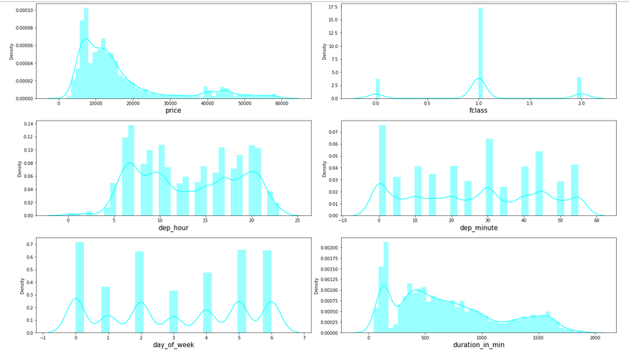
Checking for skewness for continuous variables in the dataset using the distribution plot from a seaborn library
From the above distribution, we can clearly see that continuous data variables does contain outliers.
In order to be a good dataset, we assume that all the continuous variables follow normal distribution. However I can see that the continuous columns are skewed and we will have to control skewness to make data follow normal distribution.

Slide 20
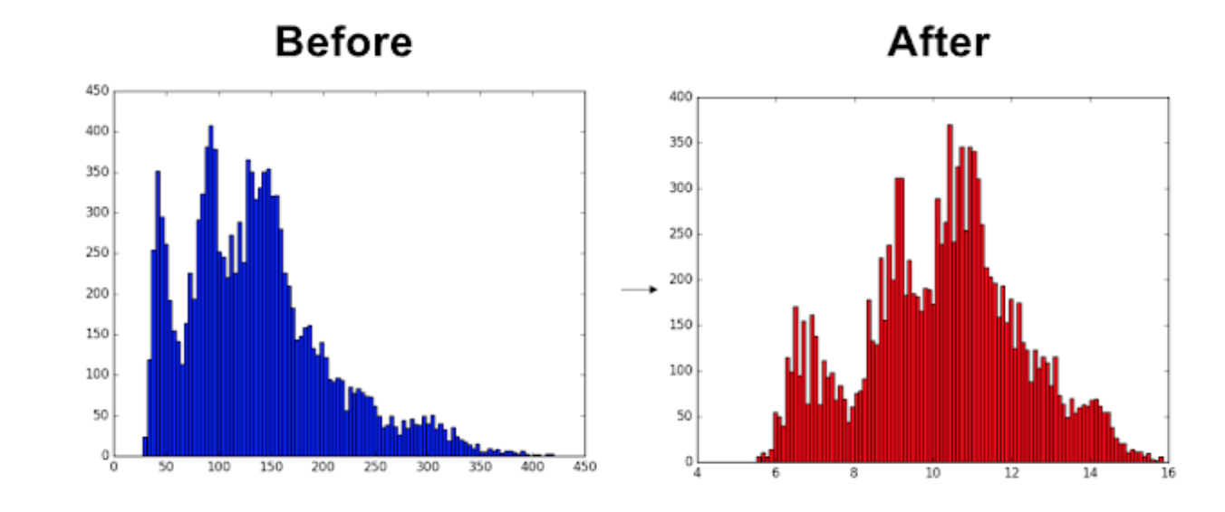
It is considered that the skewness co-efficient within the range of -0.5 to +0.5 is acceptable. Proceeding with the same assumption to get the skewness under control.
In order to perform the same we are using power transformation using yeo-Johnson method on the entire dataset excluding the target variable.

Slide 21
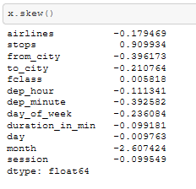
Skewness are under and we are proceeding with the model building. Checking for skewness after applying transformation technique

Slide 22
Assumptions
We assume that all the variables follow normal distribution
The multi-collinearity in the dataset will not affect the prediction.

Slide 23
Machine Learning Models
Machine Learning Models | Model's R2 score | Cross validation score | Root Mean Squared Error (RMSE | Difference of R2 and CV
Linear Regression | 0.56622 | 0.476358 | 8379.761671 | 0.089862
Random Forest Regressor | 0.951132 | 0.854238 | 2812.61413 | 0.096894
Extra Trees Regressor | 0.956394 | 0.868088 | 2656.868135 | 0.088306
XG Boost Regressor | 0.944636 | 0.871989 | 2993.724686 | 0.072647

Slide 24
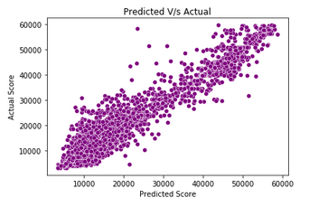
As per the previous slide the chosen best model for the dataset is Extra Trees Regressor therefore performing Hyper Parameter Tuning on the same.
Below is the plot for Actual and Predicted sale price for Hyper Tuned Extra trees Regressor

Slide 25
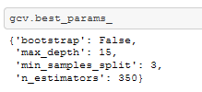
Results and Conclusion
We have successfully built a model using multiple models, we found that the Extra Trees Regressor model and performed hyper parameter tuning on the same. Below are the best parameters
Below are the details of the model’s metrics predicting the dataset
• R2- score of 0.95
• RMSE of 2799

Slide 26
Limitations of this work and Scope for Future Work.
Due to unrealistic flight prices in the website, the error might be higher for certain regions and duration of flight. For example, We can see that Bangalore to Goa flights are in the range of 5000 to 6000 and for the same date and flight there are prices greater than 10000
Due to this there might be good amount of difference than expected in the future prediction in a new dataset

Slide 27


